Slide 1



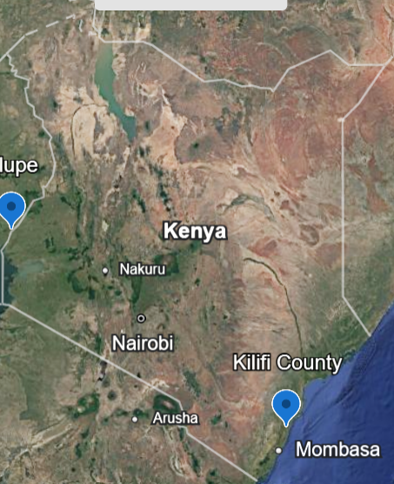
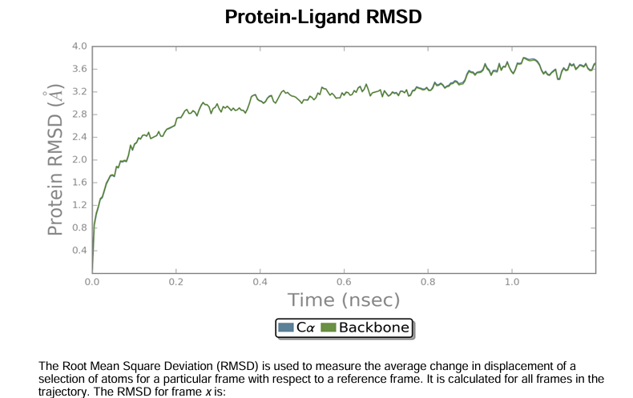
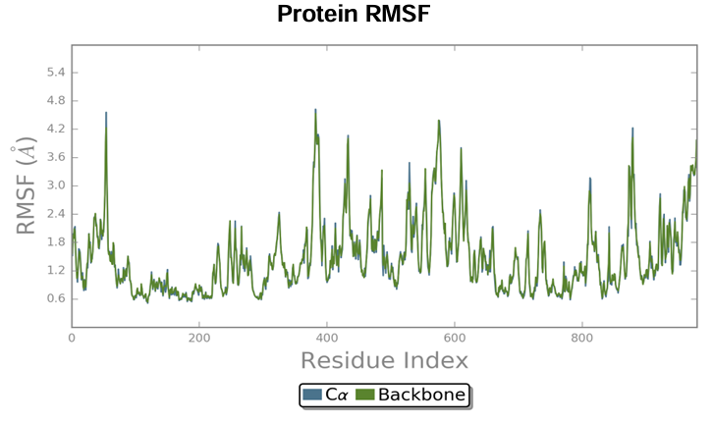
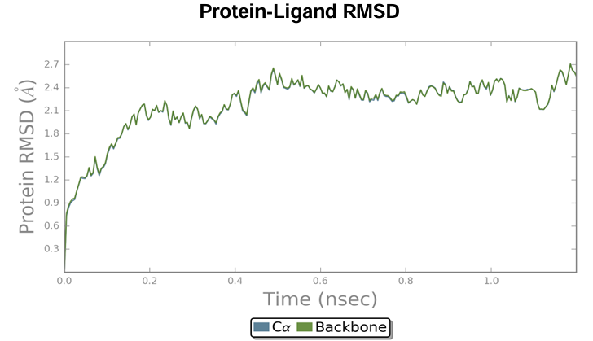
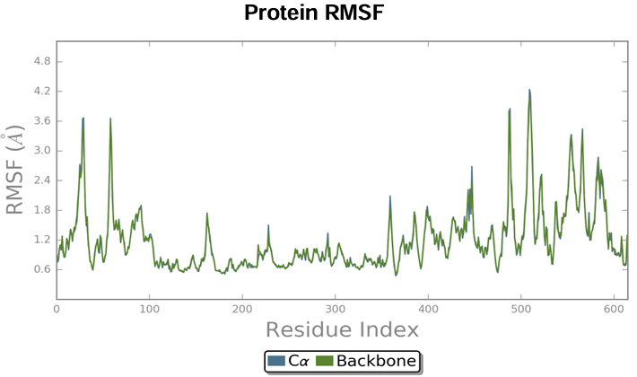
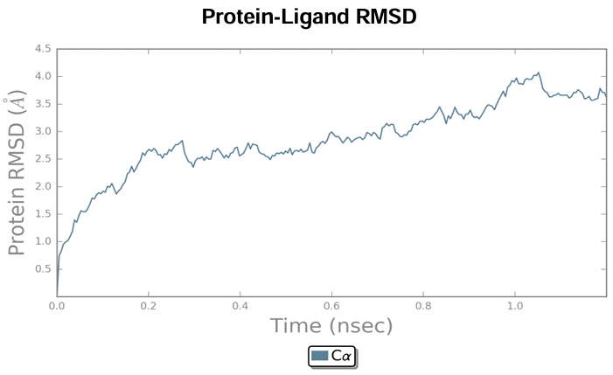
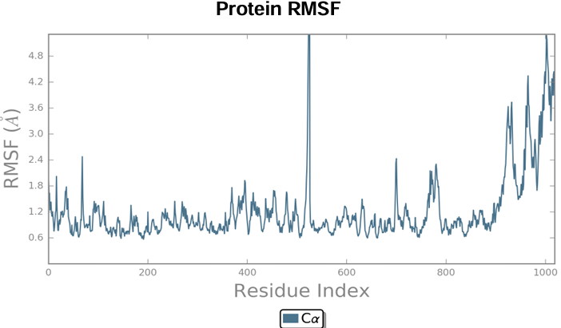
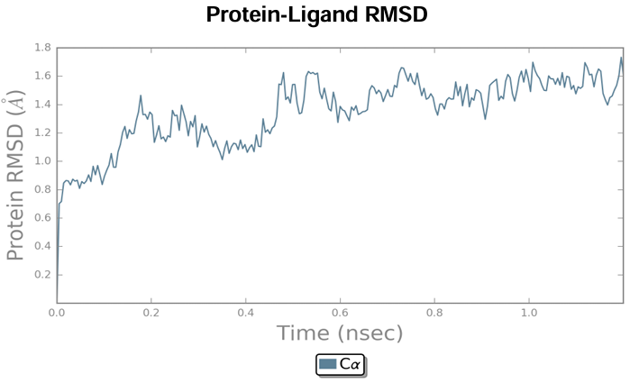
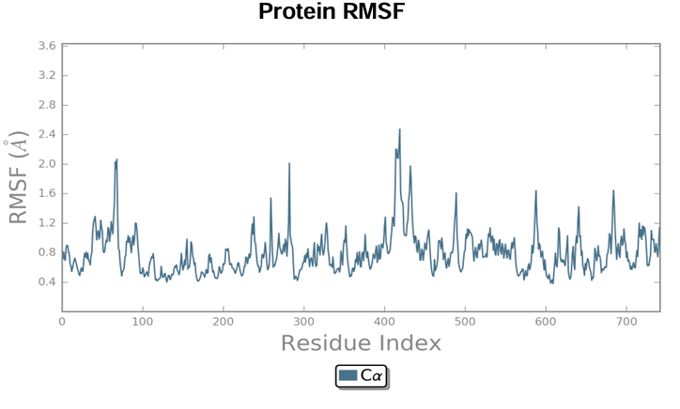
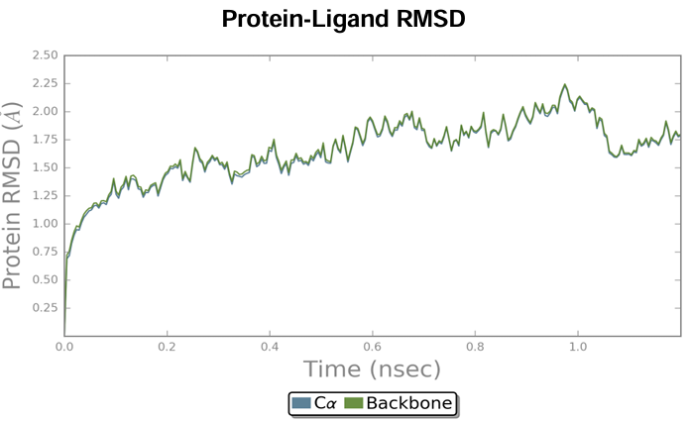
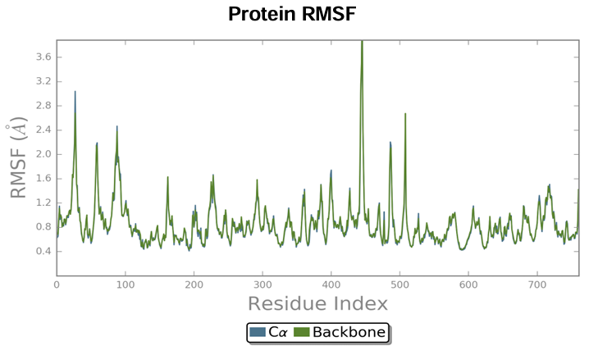

In-Silico Modeling of D29 Mycobacteriophage Protein Complexes Against Mycobacterium leprae
Lewis Mungoma Ngalla¹ , Myles Mvera Fafali ², Lywellyn Chahale Imbahale² , Claire
Njoki ² , Ngalla Jillani^{2,} Stella Irungu¹, Gerald Githinji ³.
1.Division of Reproductive Health & Biology, Kenya Institute of Primate Research, Nairobi. Kenya. 2.Division of Non-Communicable Diseases, Kenya Institute of Primate Research, Nairobi. Kenya. 3. Kenya National Public Health Institute, Nairobi, Kenya.
BACKGROUND
Mycobacteriophage D29, a lytic phage strain against Tuberculosis, has the ability to infect host bacterium and effectively kill them in the process. Its potential has been elucidated in the experimentation of susceptibility of testing against bacterial strains, particularly Mycobacterium smegmatis and Mycobacterium tuberculosis. However, D29 shows arbotive infectivity toward Mycobacterium leprae. While its antimicrobial action against Mycobacterium leprae results in abortive infection, use of phage derivatives from other studies have shown promising signs in elimination of bacterial strains.
OBJECTIVE: To model and evaluate the structural stability and dynamic behavior of D29 lytic proteins, Holin, Endolysin A (LysA), and Endolysin B (LysB), when bound to M. leprae receptors MurD and MurE, with the objective of identifying stable and functionally relevant protein-protein interactions for use as adjunct therapeutics.
METHODOLOGY: Structural Analysis and Interraction Modelling
Target Identification & Modeling: Sequences for Mycobacteriophage D29 (Endolysin A/B, Holin) and M. leprae (Mur D/E) retrieved from UniProt/NCBI; 3D models generated via Swiss Model and validated against RCSB PDB standards.
Protein-Protein Docking: Complexes modeled using HDOCK, with reliability established at a confidence threshold of >0.7.
MD Simulation: 100+ ns simulations conducted using Desmond (Maestro) under NPT conditions to sample conformational changes.
Trajectory Analysis: Structural dissimilarities quantified via Pairwise RMSD and visualized through Multidimensional Scaling (MDS) to map the conformational landscape
STUDY AREA: Kilifi, Kenya; Alupe, Kenya
Kilifi serves as a site
for Leprosy resurgence
in Kenya, consistently
recording the highest
prevalence. Alupe acts
as the specialised
referral center for
managing patients in
Kenya.
STATISTICAL ANALYSIS: The resulting MDS projection was plotted and inspected for clusters of conformations. Extreme points along each MDS axis were identified and their corresponding 3D structures were visualized in Maestro to correlate the abstract dimensions with specific biological motion.
RESULTS
DISCUSSION
RMSD, RMSF and Total SSE% values across protein complexes
RMSD analysis confirmed structural stability and equilibration across holin, LysA, and LysB complexes, where plateaus indicated reached conformational ensembles. Complementary RMSF profiles highlighted residue-level flexibility, identifying rigid core structures versus mobile loops and termini that drive dynamic responses to binding. Finally, SSE% comparisons revealed that LysB remains consistently stable (~44–48%) with both MurD and MurE. Conversely, LysA's stability is partner-dependent: it remains ordered with MurE (47.19%) but undergoes partial unfolding with MurD (22.59%). These results demonstrate that while LysB is robust, LysA’s integrity is highly sensitive to its specific binding environment.
a) LysA/MurD b) Holin/MurE
c) LysA/MurE d) LysB/MurD
e)LysB/MurE
Total SSE% across different complexes
CONCLUSIONS
This molecular dynamics study demonstrates that Holin, Endolysin A, and Endolysin B complexes with murD and murE maintain overall structural stability and reach equilibrium during simulations. While the core secondary structures remain rigid, the terminal and loop regions provide necessary flexibility, with specific binding partners influencing the dynamics of the proteins. Despite limitations in simulation length and scope, the findings provide valuable insights into the dynamic behavior of these lytic proteins. Ultimately, extending this work through longer trajectories and experimental validation will be essential for clarifying these interactions and advancing the development of novel phage-based or protein-based therapeutic strategies.
COMPLEX | Holin/murE | LysA/murE | LysB/murE | LysA/murD | LysB/murD
SSE% | 42.49 | 47.19 | 44.54 | 22.59 | 48.26
Contact: lewis.mungoma@gmail.com
ACKNOWLEDGEMENT
KENYA INSTITUTE OF PRIMATE RESEARCH
KENYA NATIONAL PUB;LIC HEALTH INSTITUTE
TECHNICAL UNIVERSITY OF KENYA

